Slide 1
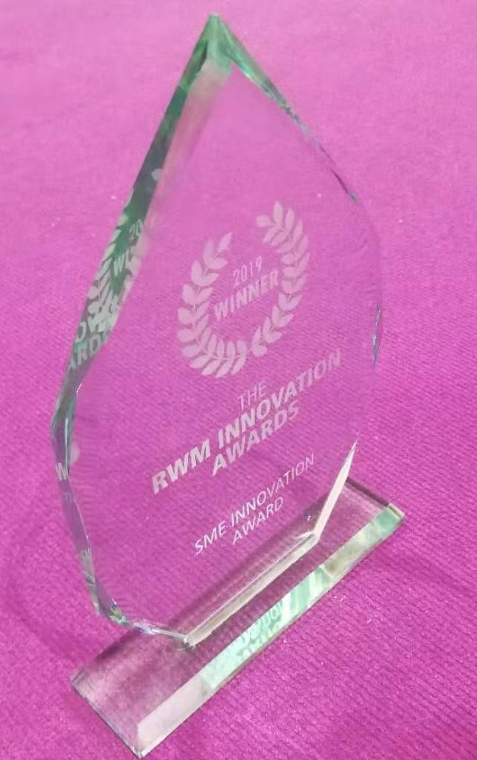

BIORESIN PLATFORM
FOR
SUSTAINABLE BIOCOMPOSITES
OVERVIEW FEBRUARY 2021

Slide 2
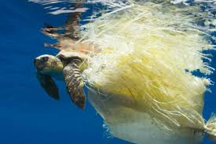
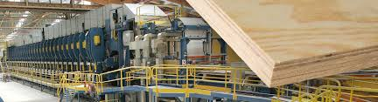


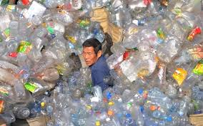
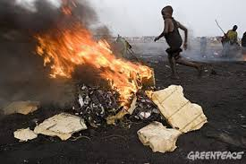
WORLD PROBLEMS- MATERIALS
EU woodpanel market €45Bn - >100 Companies
EU Plastics market €350Bn >60,000 Companies

Slide 3

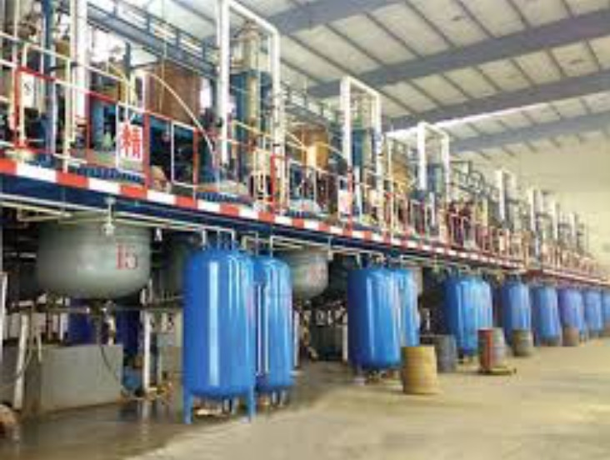


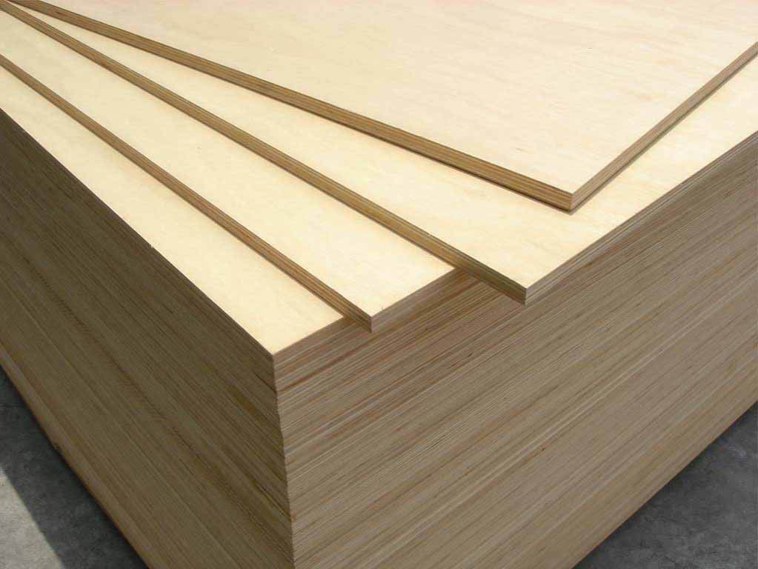
Wood Panel Industry – Global Scale and Problems
Oil Based Toxic
Urea/Phenol/Formaldehyde
Adhesives
$25BN
$350BN
Plywood, OSB, MDF for construction, furniture etc. ETC

Slide 4
DDGS – Cambond Resin Feedstock
Cambond resin is made from DDGS – Distillers Dried Grains and Solubles
Dried residue after the starch fraction of corn/wheat/barley is fermented to produce ethanol and carbon dioxide. ... DDGS is the predominant by-product and is used as animal feed.
Existing U.S. ethanol plants can produce > 60M Tonnes of DDGS.
UK produces more than 1.5M Tonnes a year.
As bioethanol production increases so does DDGS
DDGS is a global commodity available everywhere

Slide 5
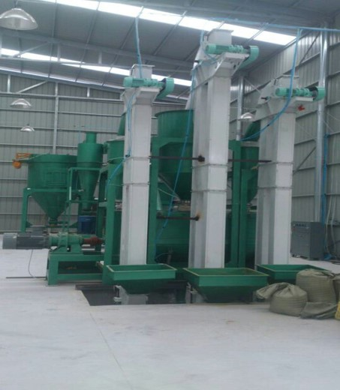
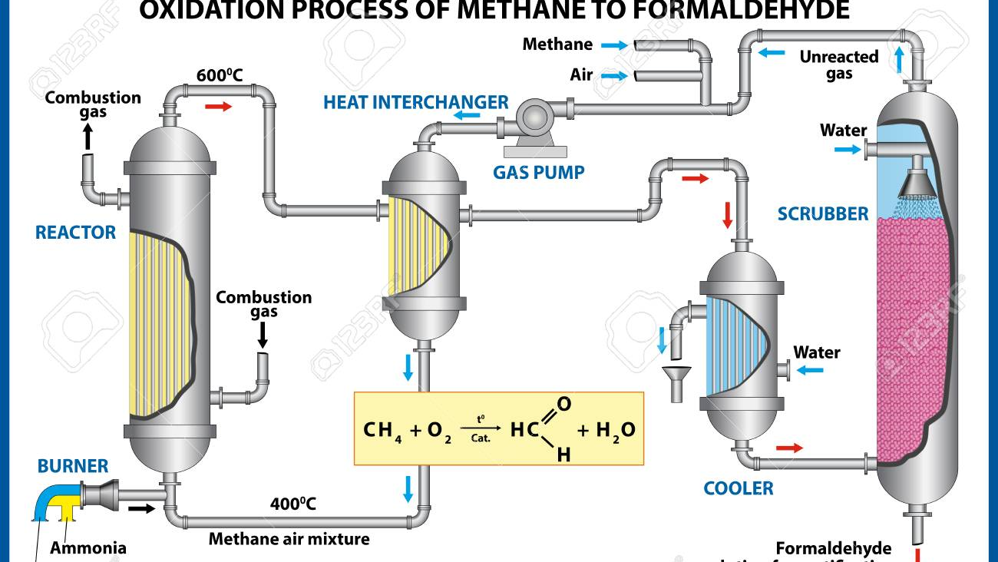
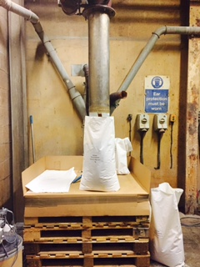
Formaldehyde vs Cambond
Food Grade
Non-toxic
40%CO_{2e}
Toxic
High Energy
Regulated

Slide 6
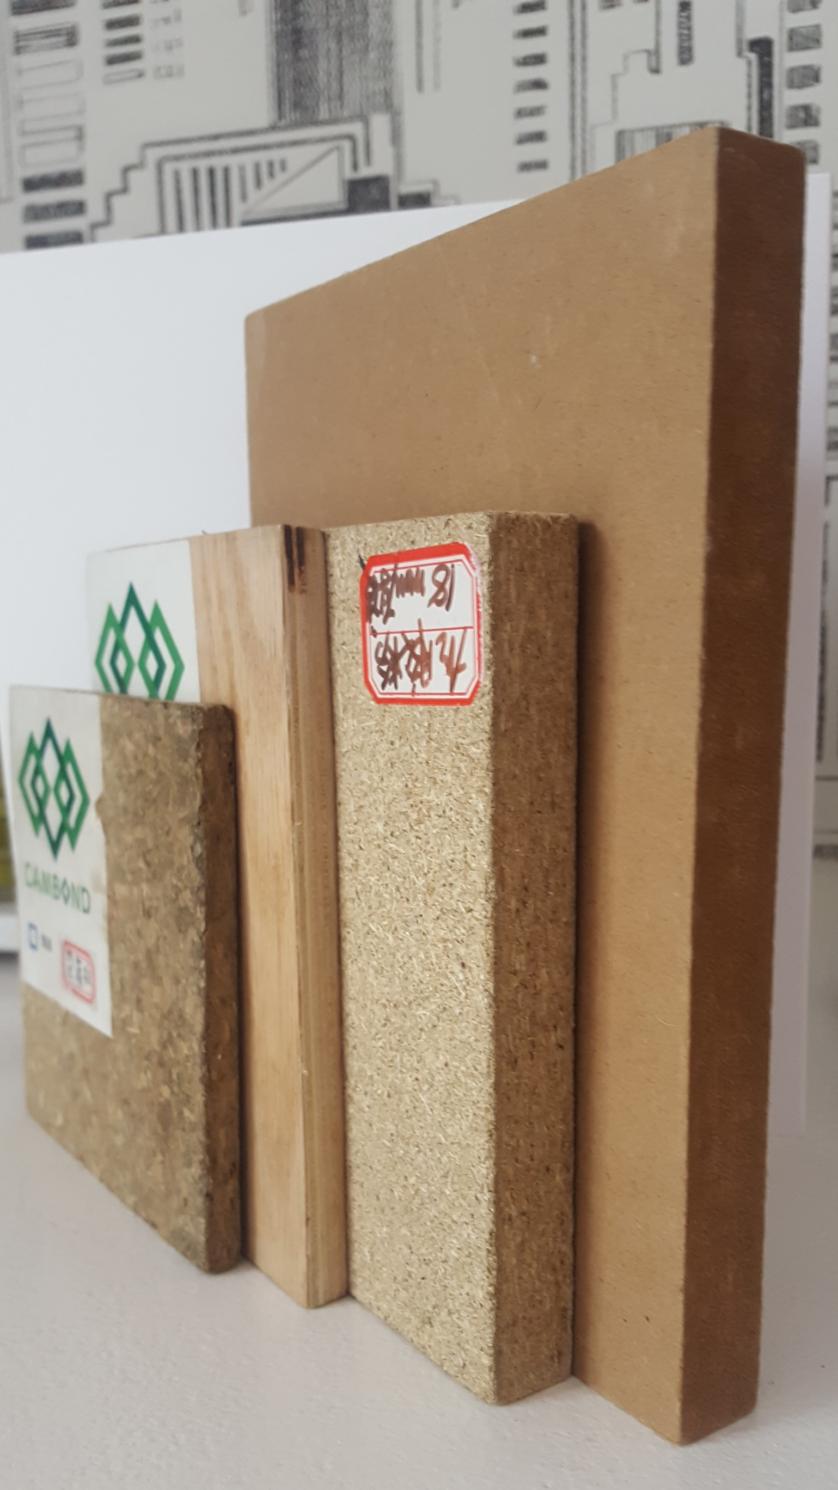
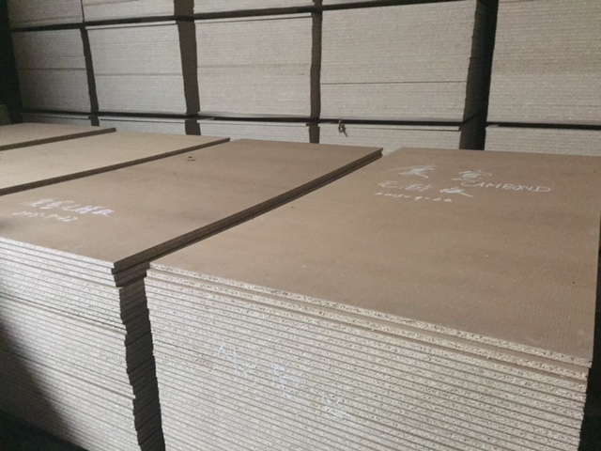
Cambond Resin can make wood panels
Replace urea/formaldehyde in plywood, MDF, OSB and particleboard manufacture.
No toxic formaldehyde.
Each board will have a reduced CO₂ footprint (upto 40% less by LCA analysis).
Uses existing machinery.
Working with manufacturers of ‘high end’ architectural products e.g. Foresso.
Trying to organise large scale manufacturing trials in UK

Slide 7

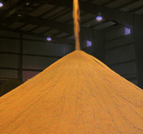
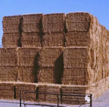
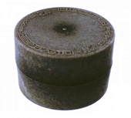

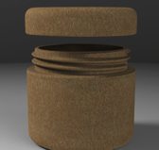
CAMBOND INNOVATION AND SUPPLY CHAIN
REED
DDGS
WOOD PANELS
STRAW
MOULDED PRODUCTS
CAMBOND
RESIN MAKES A RANGE OF BIO-COMPOSITES
PALM OIL
WASTE
BIOPLASTIC
PRODUCTS

Slide 8
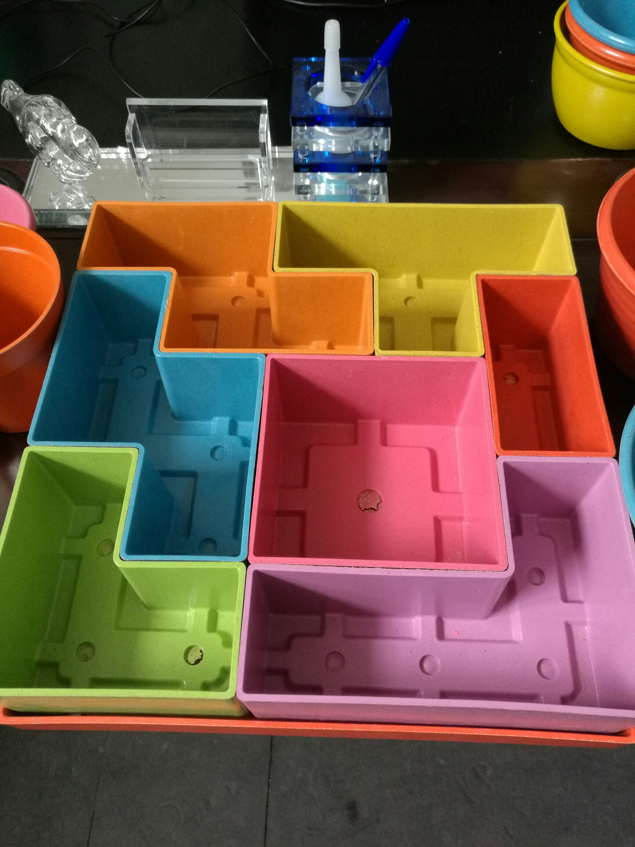
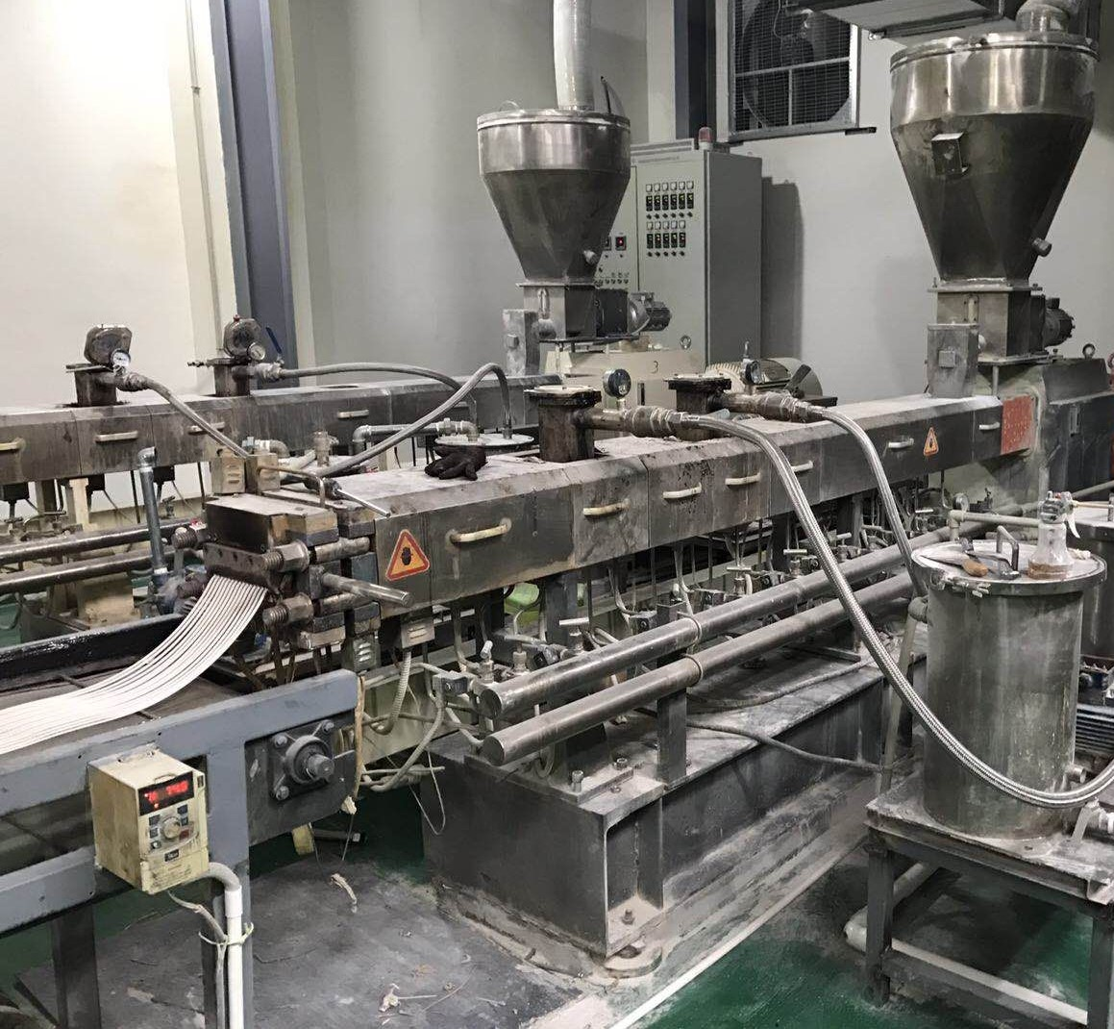
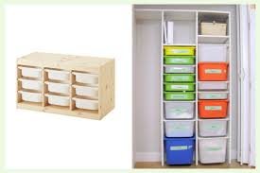
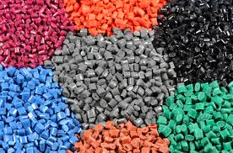
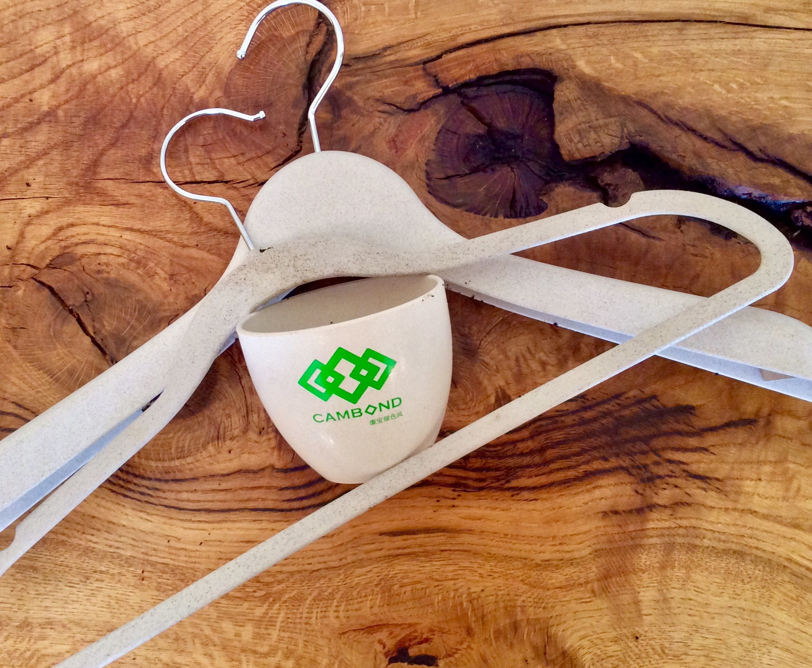
CAMBOND INNOVATION -
REED
DDGS
BIOMASS
ALGAE
Biomass/polymer composites
Low carbon
Low cost
EXISTING SUPPLY CHAIN

Slide 9
COMMERCIALISATION – VALUE PROPOSITION
Cambond technology
Better use of waste streams
Cleaner environmentally friendly manufacturing
Reduce COST of manufacturing feedstocks
Low toxic chemicals, solve environmental
Carbon footprint (<40%)
Cambond technology reduces carbon helps clean environment.

Slide 10
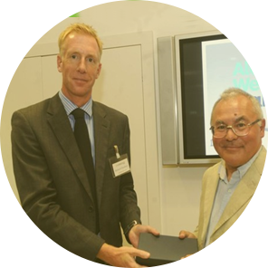
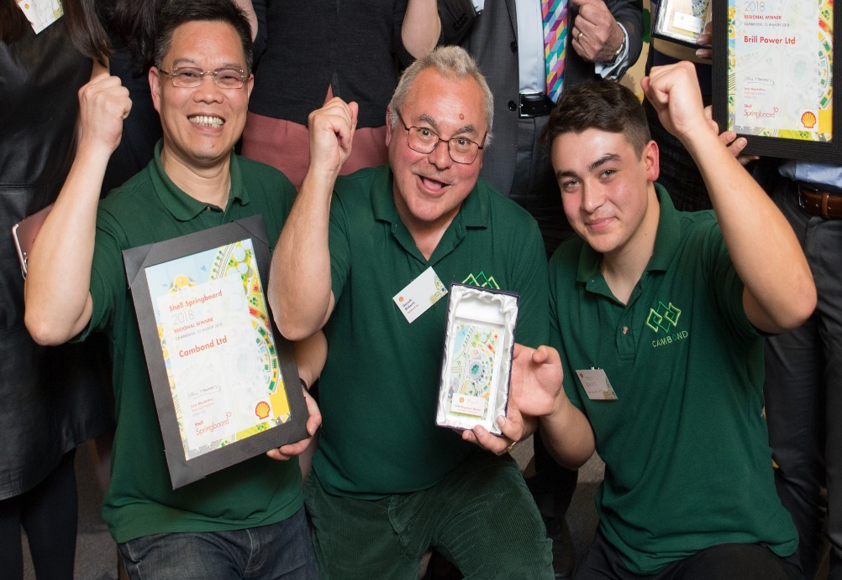
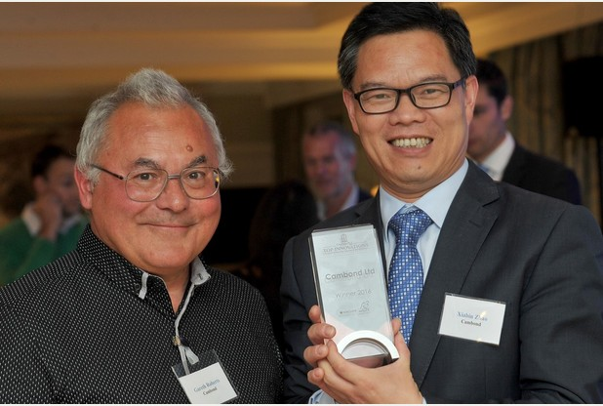

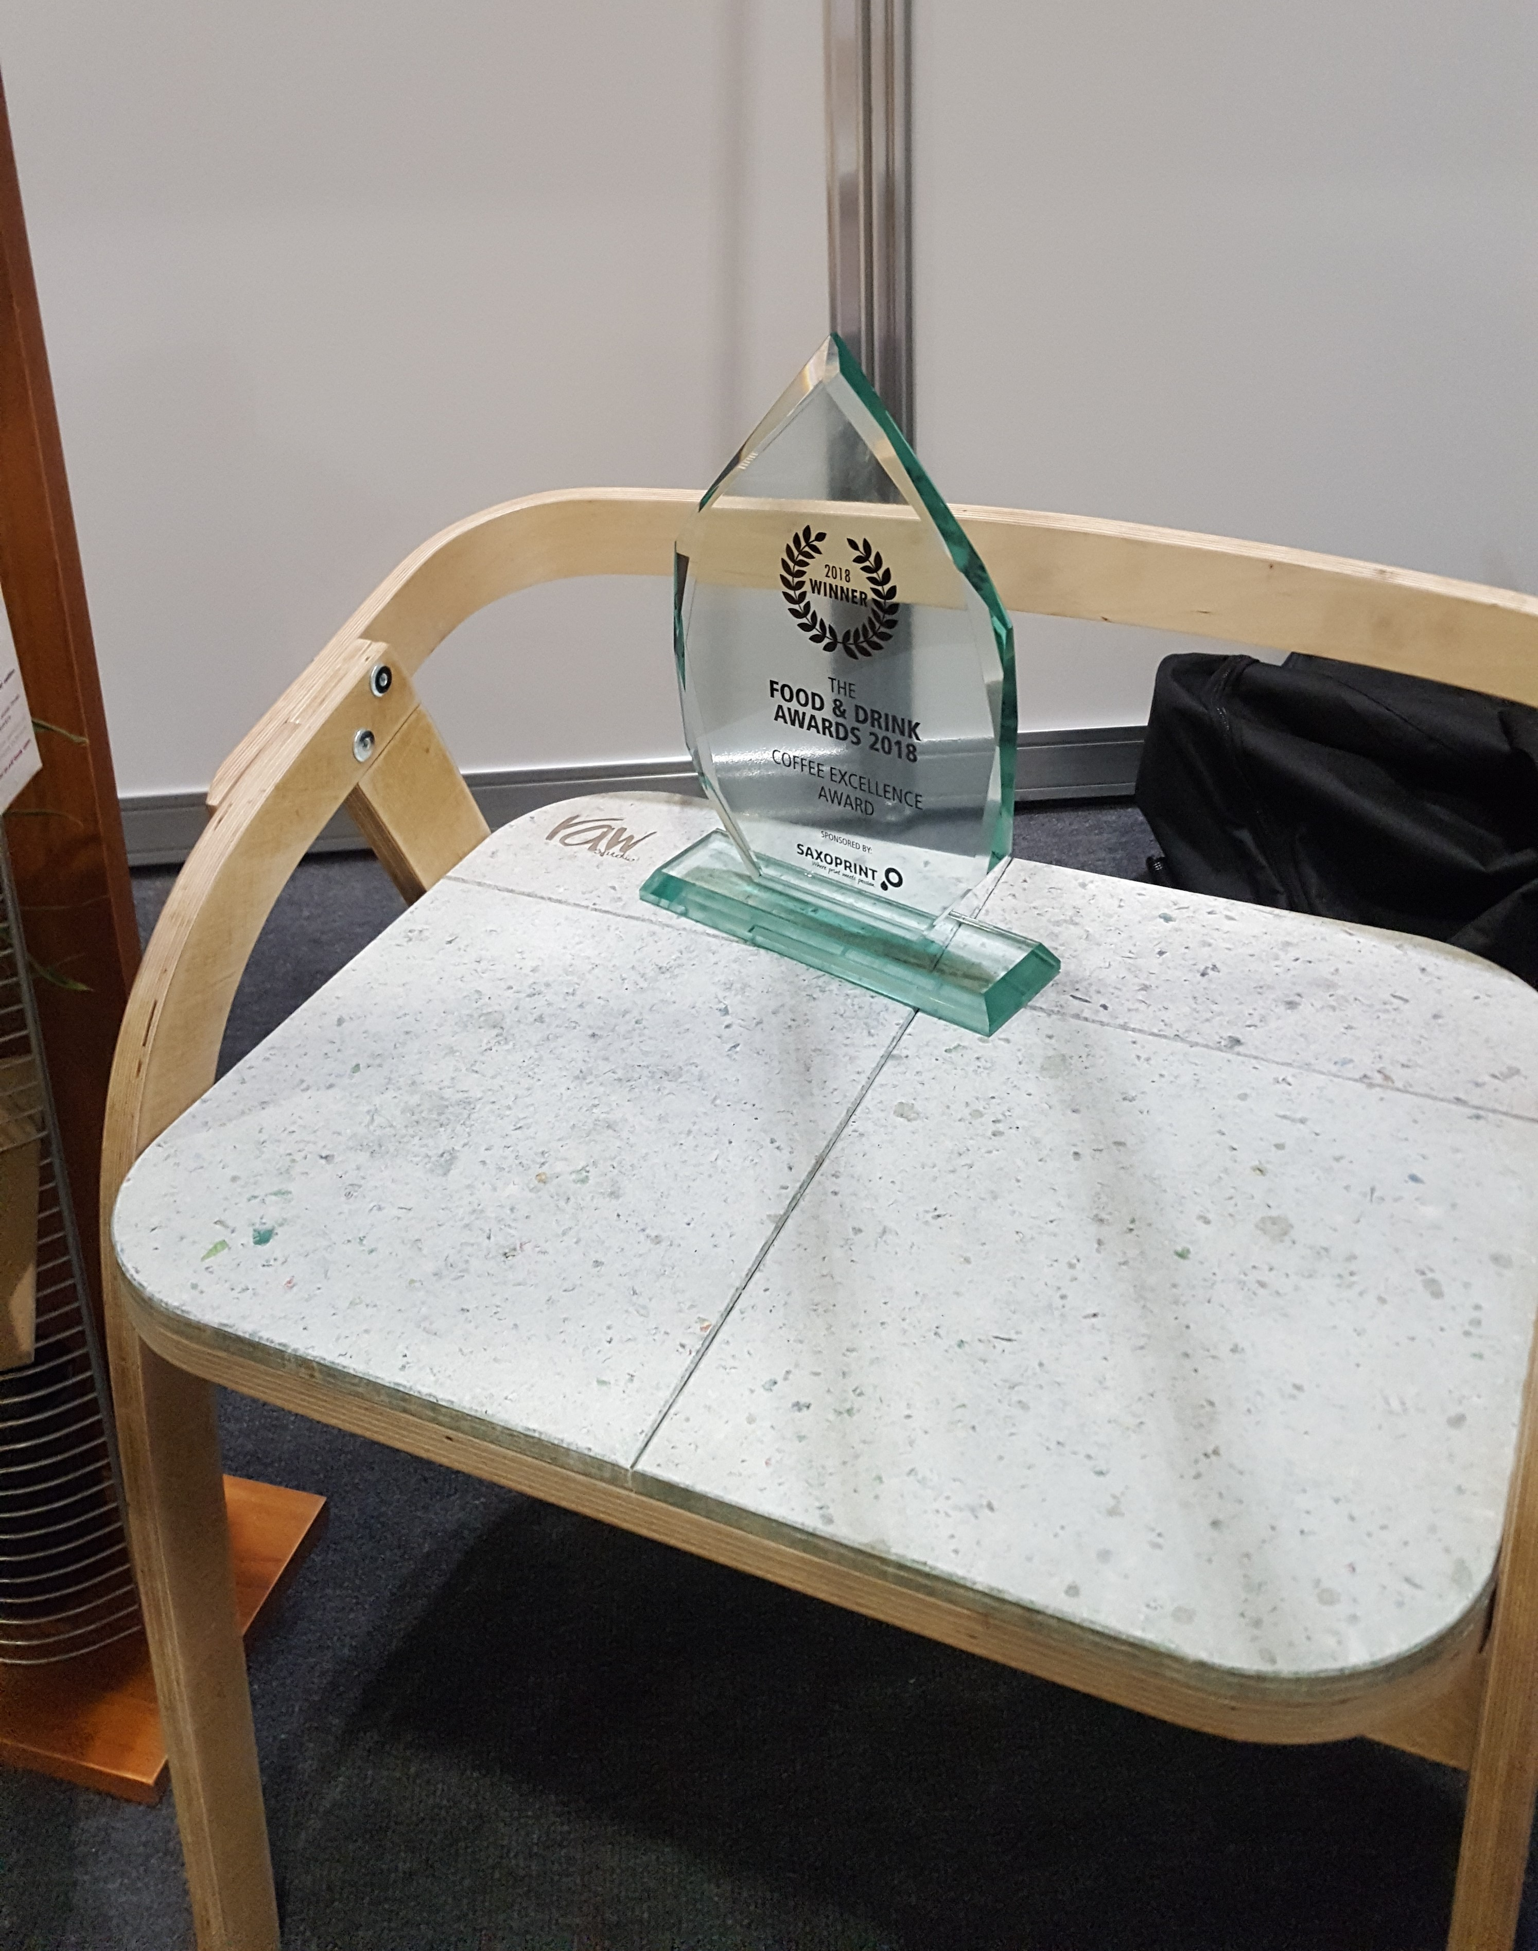
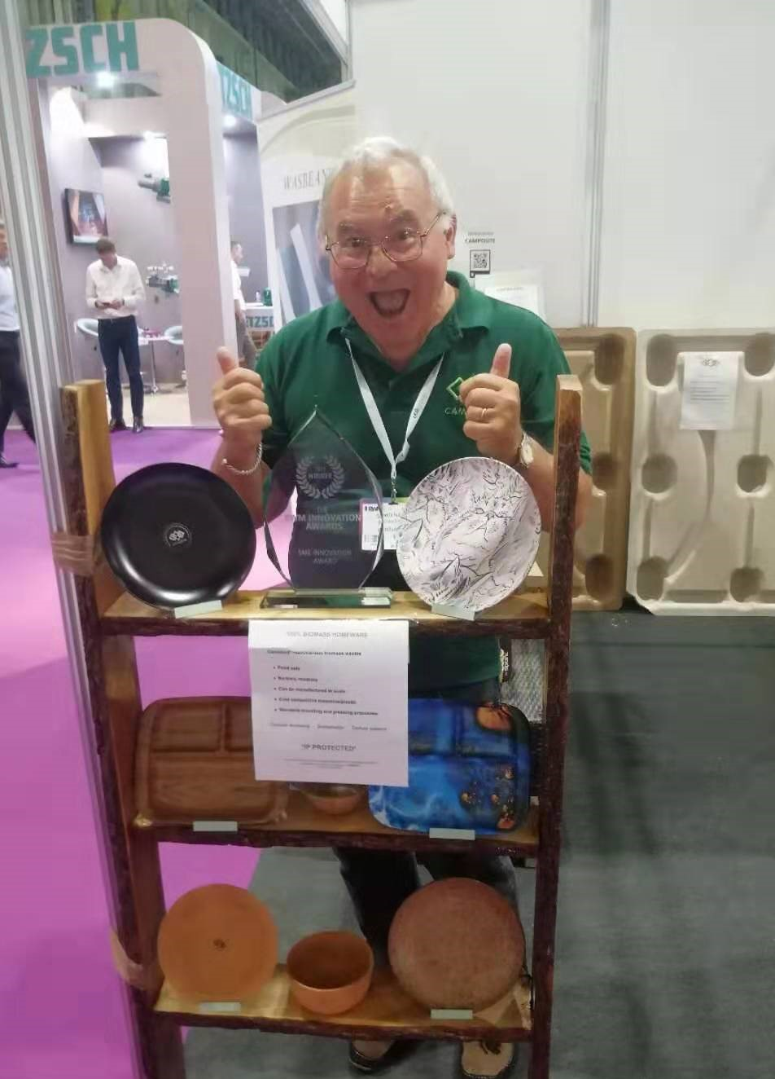
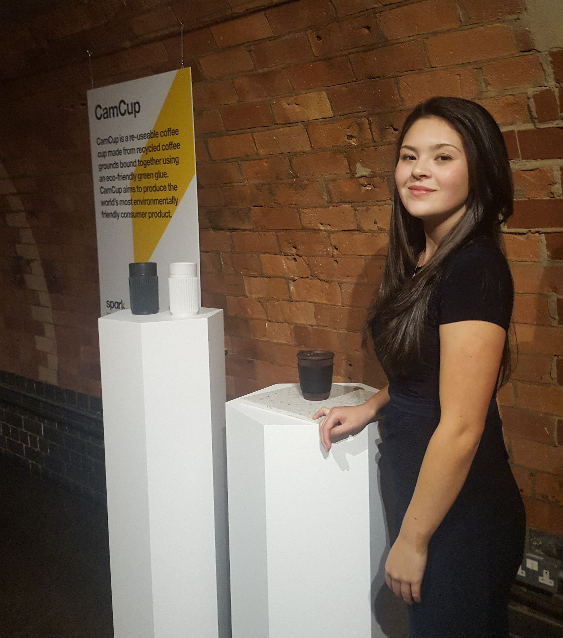
CAMBOND
Dr. G Roberts
2014 Top Innovations Awards
Shell Springboard
2018
Prof. X Zhao
2014 Royal Society of Chemistry Emerging Technology Business
Coffee Excellence 2018
Design Council 2017

Slide 11


www.cambond.co.uk
Address: Future Business Centre, Cambridge CB4 2HR
Tel: 44- 01223 911505
Mobile: 44 -7507949517
Email: xzhao@cambond.co.uk
groberts@cambond.co.uk
cambond@xiaobinzhao1

